Slide 1

Block Diagrams & Signal-Flow Graphs
Ref: Automatic Control Systems, 9th Edition
F. Golnaraghi & B. C. Kuo

Slide 2
Main Objectives
To study block diagrams, their components, and their underlying mathematics.
To obtain transfer function of systems through block diagram manipulation and reduction.
To introduce the signal-flow graphs.
To establish a parallel between block diagrams and signal-flow graphs.
To use Mason’s gain formula for finding transfer function of systems.

Slide 3
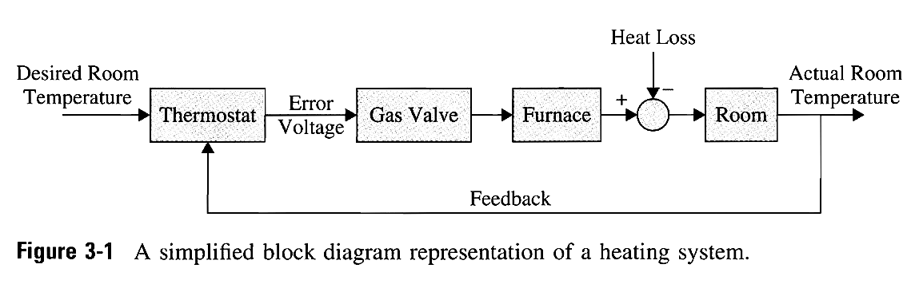
Block Diagrams
Block diagrams: the composition and interconnection of the components of a system
⇒ describe the cause-and-effect relationships throughout
the system.
Disturbance
Input
actuator
Output
Error
comparator

Slide 4
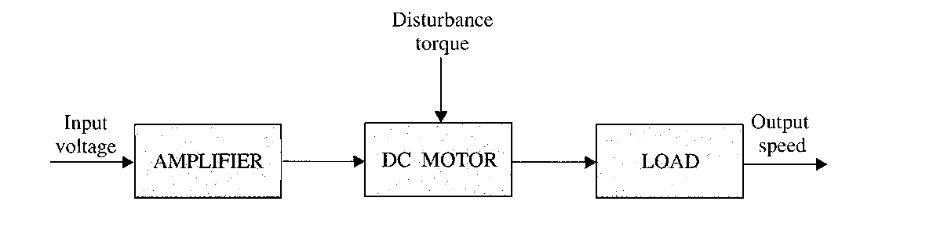



DC-Motor Control System
system components
(a) Block diagram of a dc-motor control system.
linear range
(b) Block diagram with transfer function and amplifier characteristic.

Slide 5

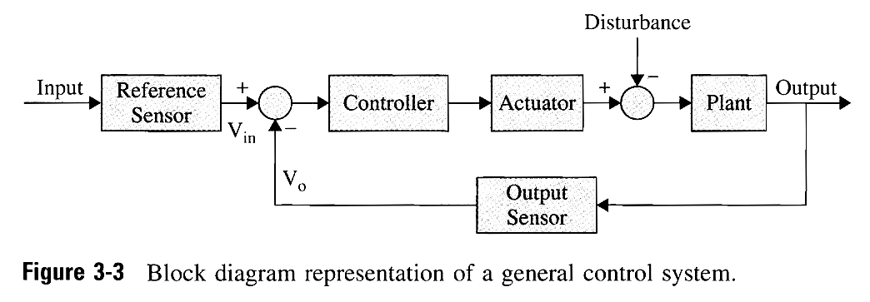

Typical Elements of Block Diagrams in
Control Systems
comparator
feedback loop
Typical block elements: plant, controller, actuator, and sensor

Slide 6
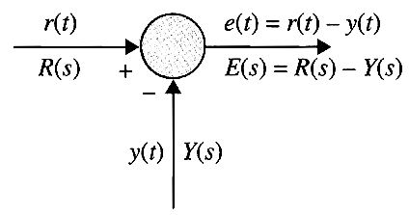
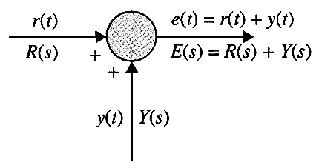
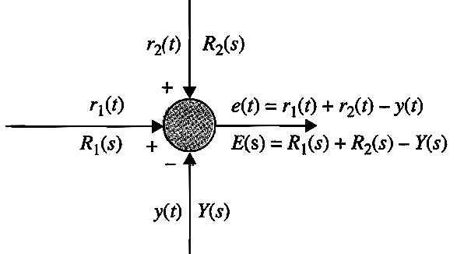
Block-Diagram Elements of Comparators
(a) Addition
(b) Subtraction
(c) Addition and subtraction
Fig. 3-4 Block diagram elements
of typical sensing devices of
control systems.

Slide 7
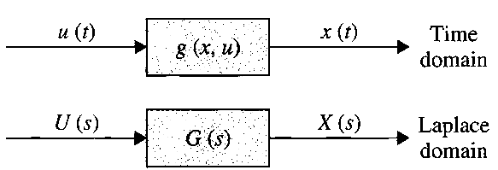
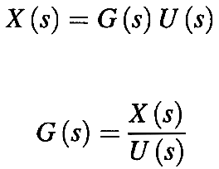


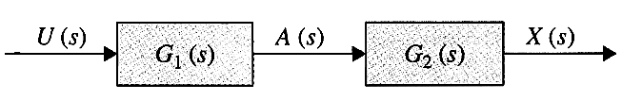

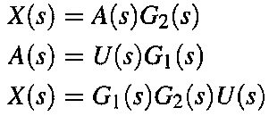



Time & Laplace Domain Block Diagrams

Slide 8
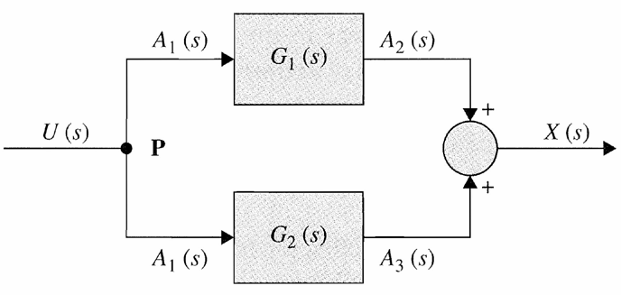
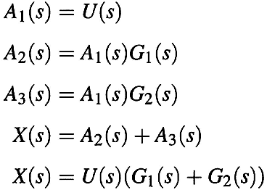




Example

Slide 9

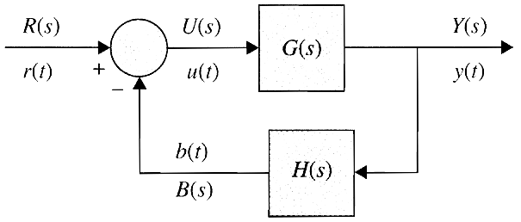








Linear Feedback Control System
actuating signal
reference input
(command)
output
(controlled variable)
feedback signal
Negative feedback:
Positive feedback:

Slide 10
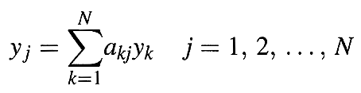

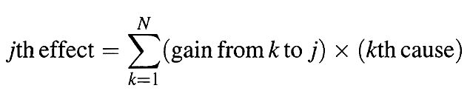



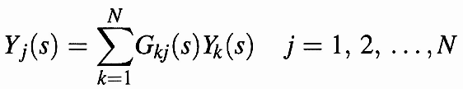







Signal-Flow Graphs (SFGs)
Input-output (cause-and effect) relations:
Basic elements of an SFG:
A signal can transmit through a branch only in the direction of the arrow.
branch gain
input
output

×

Slide 11
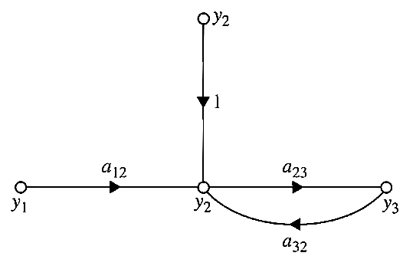
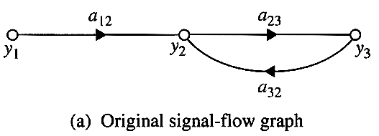
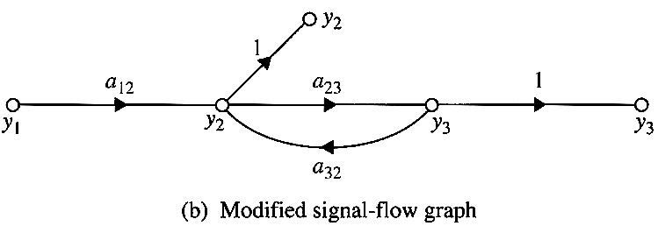





Definition of SFG Terms (1/3)
Input node (Source): only outgoing branches, e.g.,  in Fig. 3-26
Output node (Sink): only incoming branches, e.g.,  in Fig. 3-26
We can make any noninput node of an SFG an output.
We cannot convert a noninput node into an input node.

Slide 12
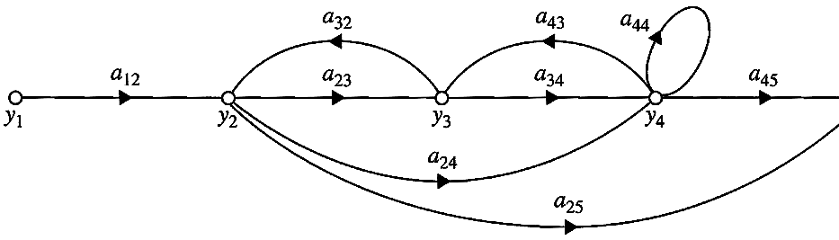


Definition of SFG Terms (2/3)
Path: any connection of a continuous succession branches traversed in the same direction, e.g., y₁– y₂– y₃ or y₂– y₃–y₂.
Forward Path: a path that starts at an input node and ends at an output node and along which no node is traversed more than once.
Path Gain: the product of the branch gains encountered in traversing a path,
e.g., path = y₁– y₂– y₃ – y₄ ⇒ path gain = a₁₂a₂₃a₃₄
Forward-Path Gain: the path gain for a forward path.

Slide 13



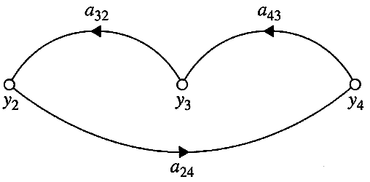
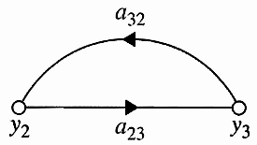
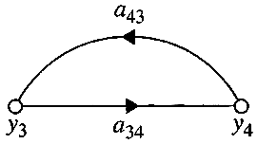
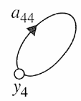
Definition of SFG Terms (3/3)
Loop: a path that originates and terminates on the same node and along which no other node is encountered more than once.
Loop Gain: the path gain of a loop.
Nontouching Loops: they do not share a common node.
Nontouching Loops

Slide 14


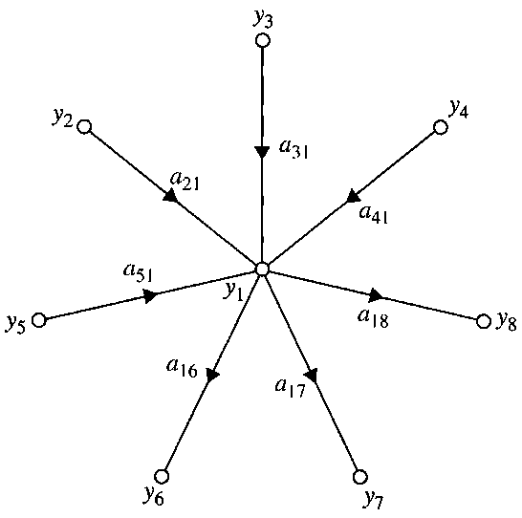
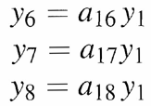

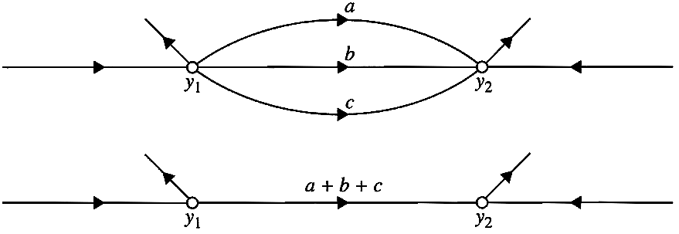


SFG Algebra
the sum of all signals entering the node
transmit through all branches
leaving the node
Parallel branches:

Slide 15



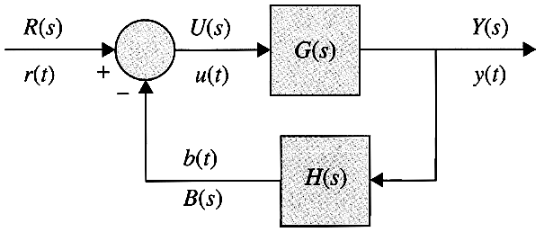

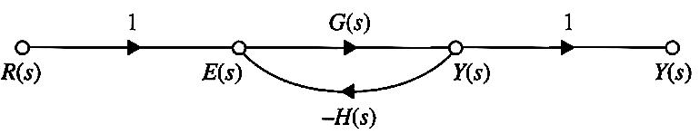


SFG Algebra & Feedback Control
Series connection:
SFG of a Feedback Control System:

Slide 16
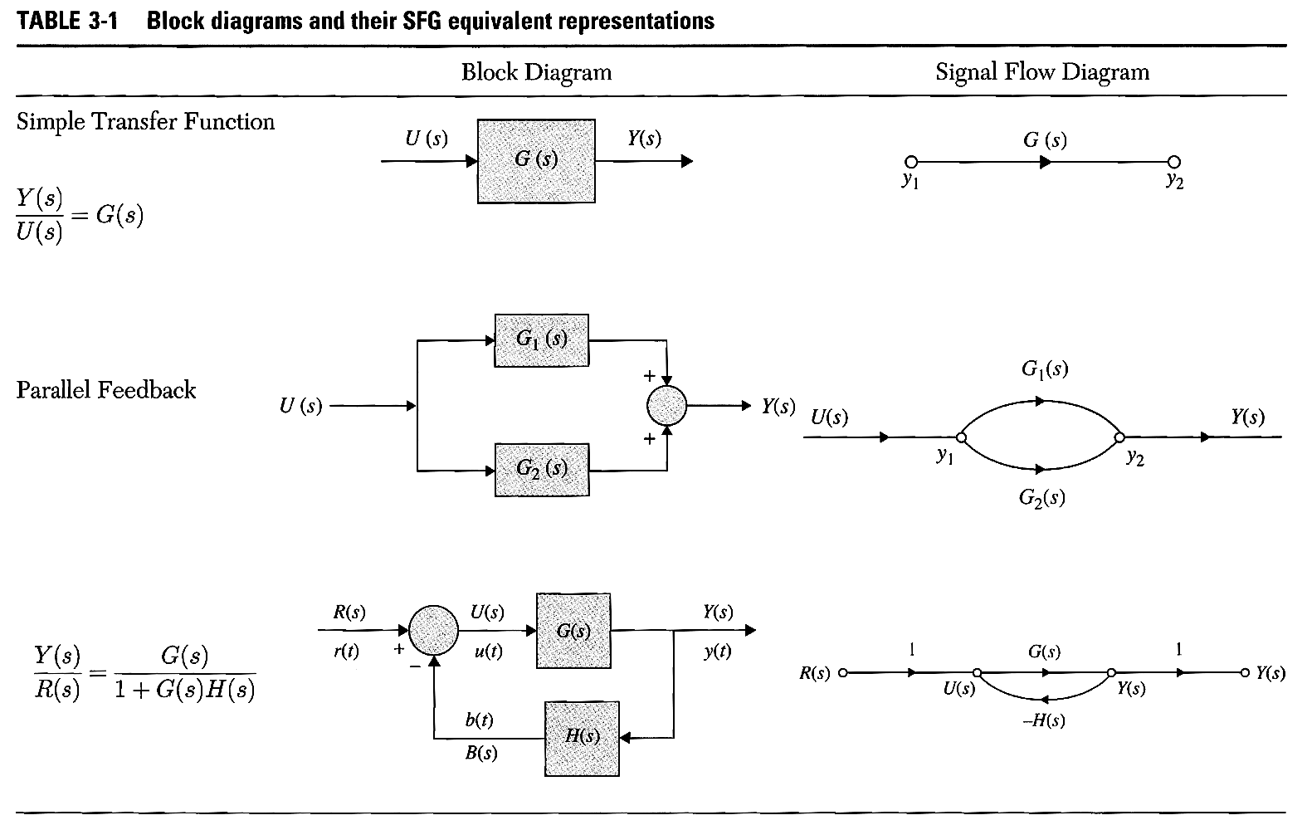
Relation between Block Diagram & SFGs

Slide 17
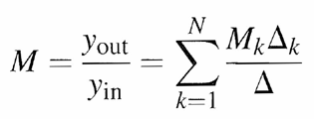

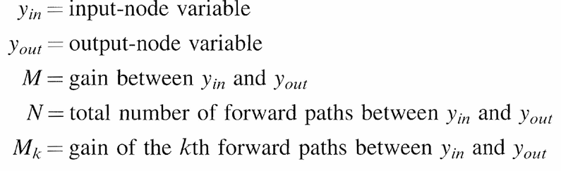
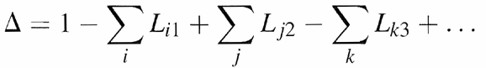

Gain Formula for SFG
Mason’s gain formula:
L_{mr}= gain product of the mth possible combination of r nontouching loops
Δ = 1 − (sum of the gains of all individual loops) + (sum of products of gains of
all possible combinations of two nontouching loops) − (sum of products of
gains of all possible combinations of three nontouching loops) + − + − …
Δ_{k} = the Δ for that part of the SFG that is nontouching with the kth forward path

Slide 18
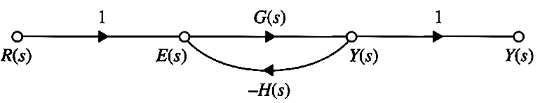








Example
Y(s) / R(s) = ?

Slide 19
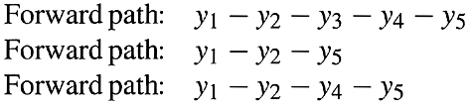
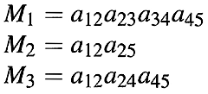







Example
y₅ / y₁ = ?
Three forward paths:
Four loops:
One pair of nontouching loops:

Slide 20
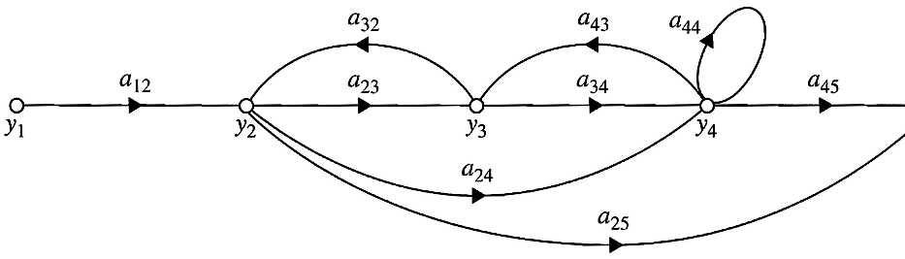

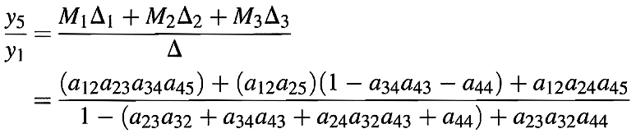


Example 3-2-3 (cont.)

Slide 21
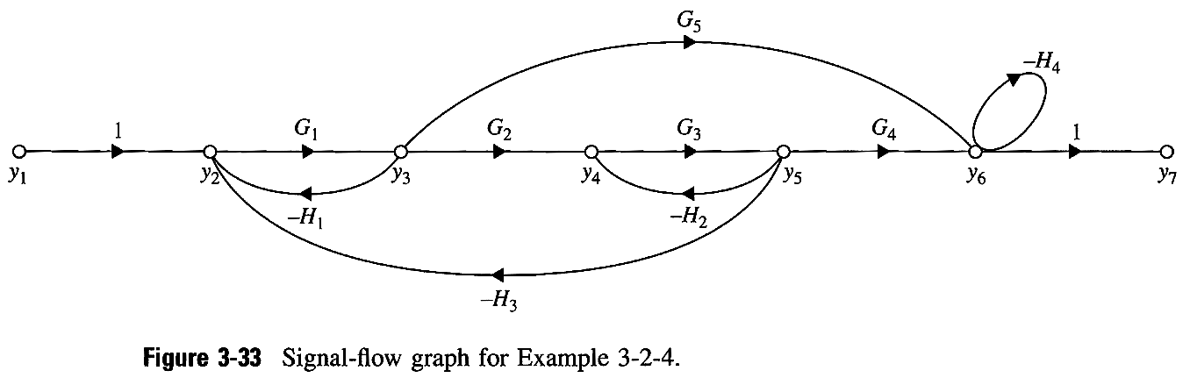








Example

Slide 22
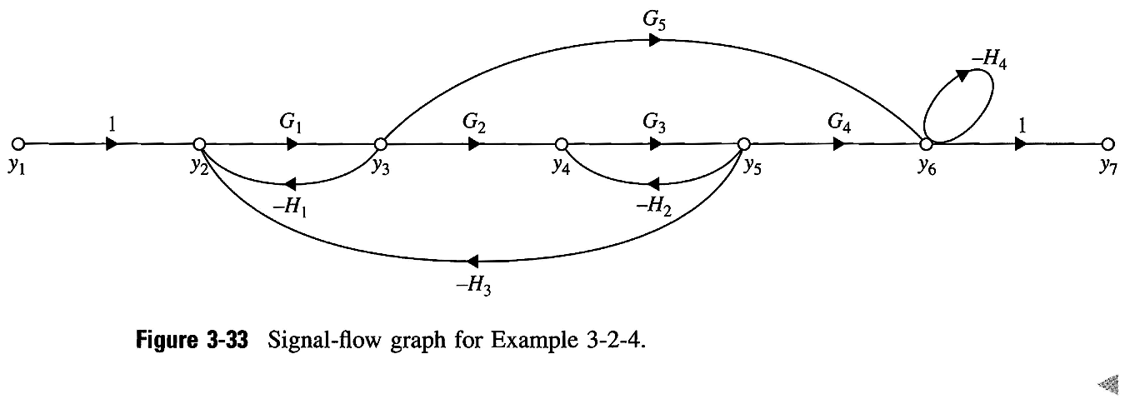
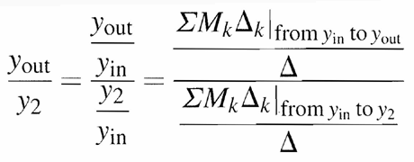





Gain Formula between Output Node and Noninput Nodes & Example
Example :

Slide 23
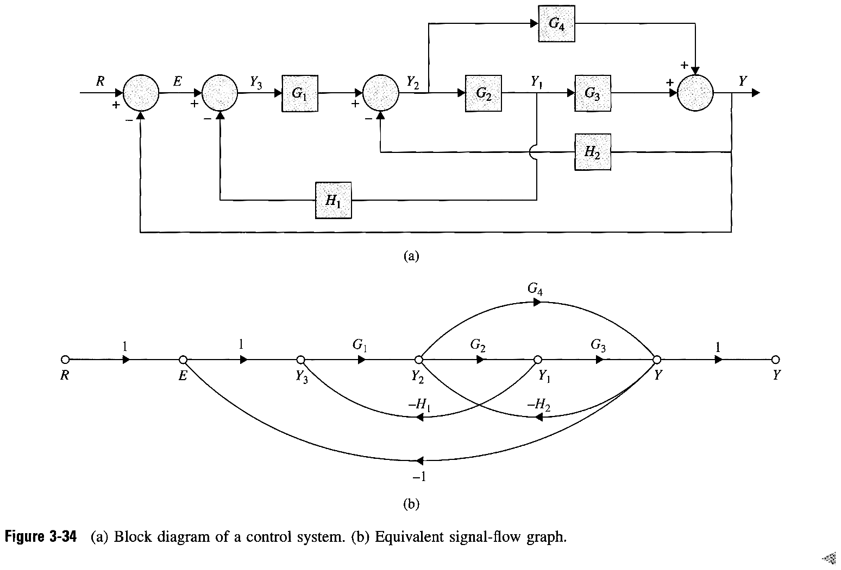
Application of Gain Formula to Block Diagram

Slide 24
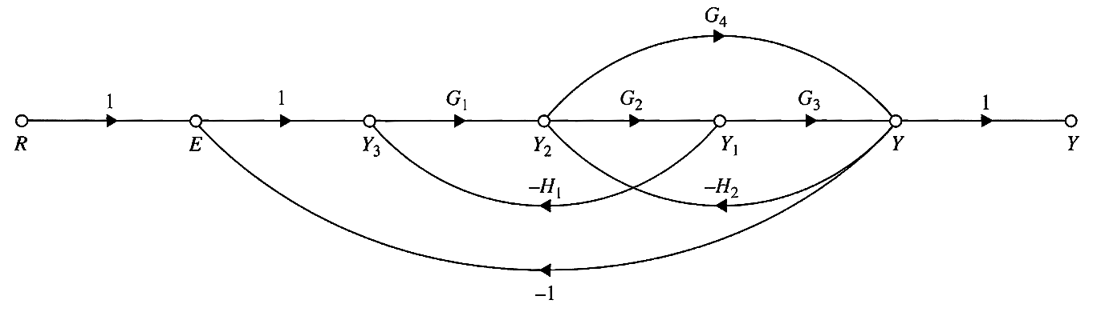








Example

Slide 25
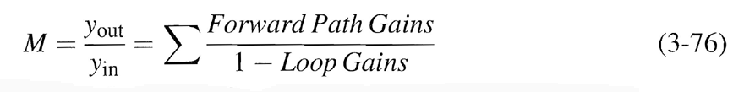

Simplified Gain Formula
All loops and forward paths are touching:
Example:

